Slide 1
Constrained Bayesian Optimization of Criticality Experiments at LLNL
IEAE Consultancy Meeting on Machine Learning for Nuclear Data
Daniel Siefman
Thursday December 10, 2020

Slide 2

Integral Experiment Design Challenge
Must be optimal with respect to a variable (objective)
  Intermediate fission fraction
  EALF
  Sensitivity to specific reaction of specific nuclide at specific energy range
  Representativity of criticality safety application
  …
Must respect constraints
  Criticality
  Height-to-diameter ratio
  Weight
  Cost
  …
Designs simulated with Monte Carlo (MC) codes
Challenge: Find best design with least code executions and least headache
Notes:
EALF: energy corresponding to the average neutron lethargy causing fission

Slide 3
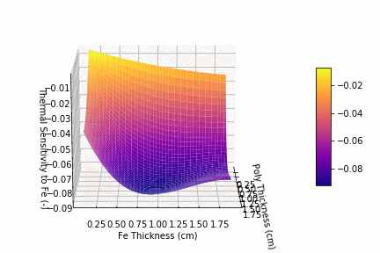

Which Design Maximizes Sensitivity?
Thermal Iron Sensitivity vs. Design Parameters
Notes:
At <0.625 eV
Total cross section
For all isotopes of Fe

Slide 4
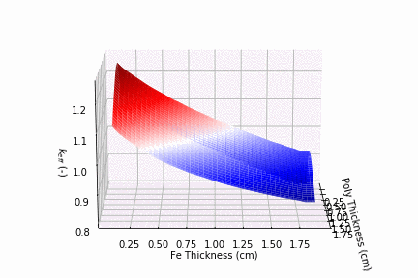
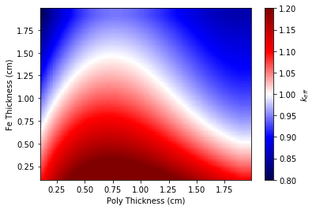

What combination makes a critical experiment? k_{eff} vs. design parameters
Linear addition absorber
under-moderated
over-moderated
Notes:
20x20 grid (400 simulations) at k_{eff} ± 50 pcm

Slide 5
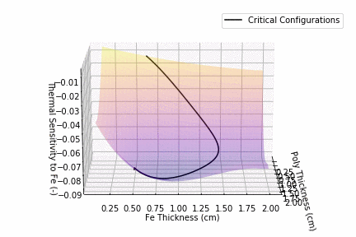
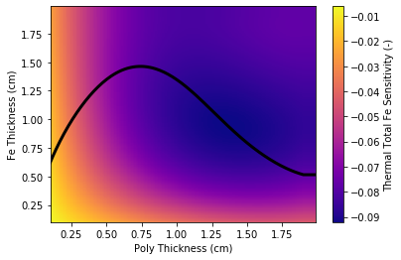
What Does Both?
Critical Configurations in Sensitivity Space

Slide 6
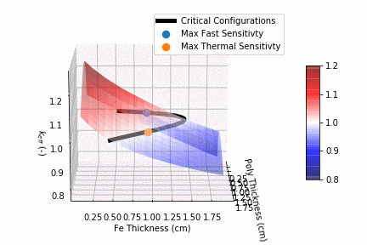
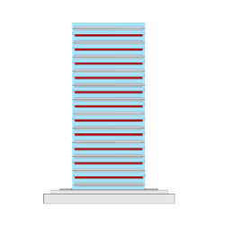
Optimal Designs

Slide 7
Optimization Strategy
Idea:
  Surrogate model of MC code
  Use model to find the optimal design
  Avoid expensive MC
Questions:
  Which surrogate model?
  How to minimize MC simulations?
    Balance between accurate regression and minimizing computational cost
One Solution:
  Gaussian processes
  Efficient global optimization
Competing Desires
Model Accuracy & Fitting Cost
Number Monte Carlo Simulations
Notes:
Things to consider:
Training data is uncertain: output of MC code
Parameter space is relatively small (1-10 variables)
Non-linear behavior
Cost of fitting surrogate model can’t exceed cost of MC simulations
Loads of surrogate models:
Linear regression
Polynomials
Splines
Support vector machines
Neural networks
Radial basis function
Gaussian processes

Slide 8

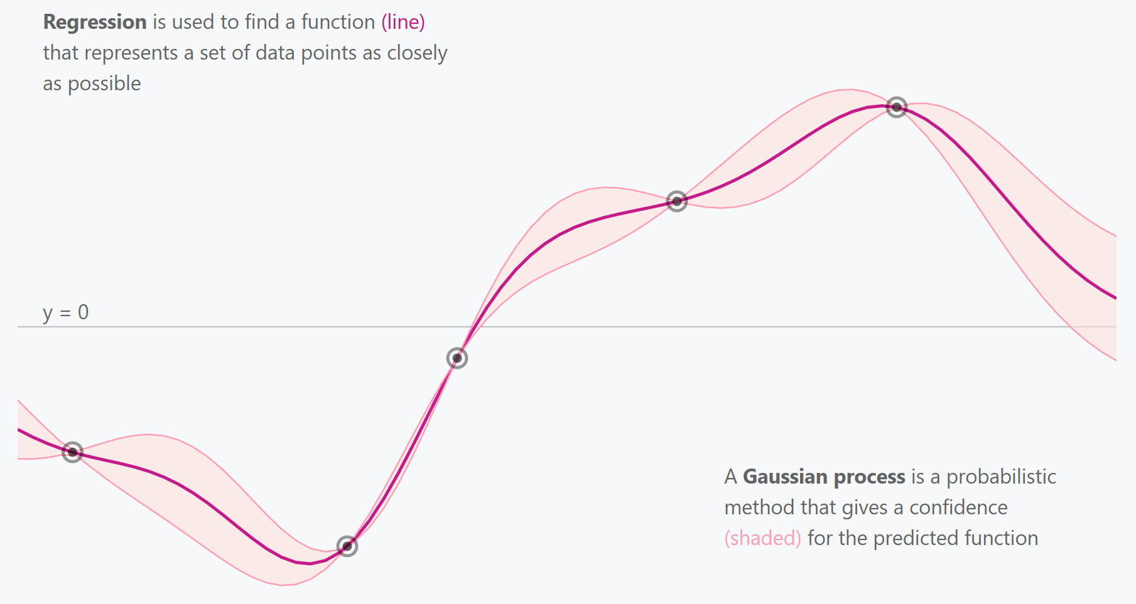

How to Add Training Data Efficiently
Adding training data is expensive
  MC simulations
  Experiments
For optimization, only want to add it near a max or min
How do we efficiently choose where to add new points?
An answer: Bayesian Optimization
Bayesian Optimization: algorithm for finding an optimum
  Fit GP
  Choose new training data
  Find the optimum

Slide 9
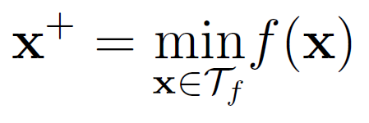
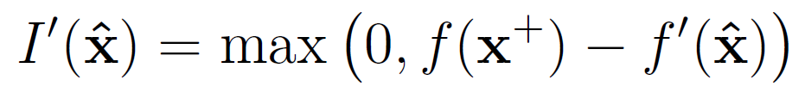

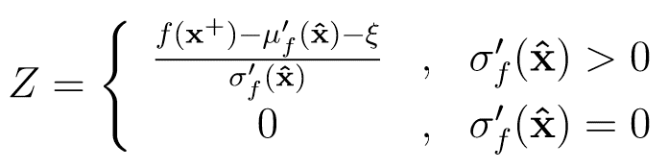
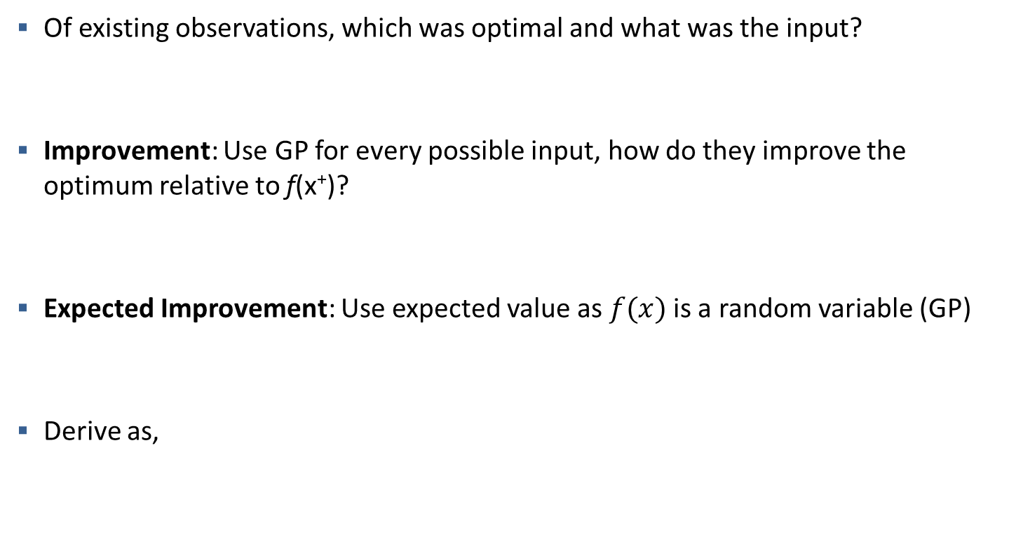
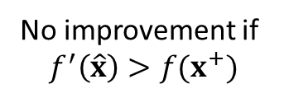
Expected Improvement (EI)
An Acquisition Function
Of existing observations, which was optimal and what was the input?
Improvement: Use GP for every possible input, how do they improve the optimum relative to f(x⁺)?
Expected Improvement: Use expected value as $f(x)$is a random variable (GP)
Derive as,
No improvement if
$$f^{′}\left(\hat{x}\right)>f(x^{+})$$
Notes:
Tau is the design set: $\mathcal{T}_f = \{\big(x_1, f(x_1)\big), \cdots, \big(x_n, f(x_n)\big)\}$

Slide 10
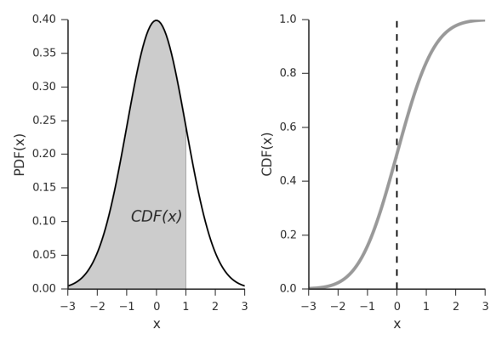
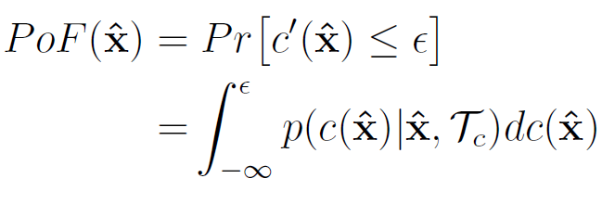


What About a Constraint?
Probability of Feasibility
Define feasibility indicator $Δ\left(x\right)$
  $Δ\left(x\right)$ = 1 if constraint satisfied
  $Δ\left(x\right)$ = 0 if constraint not satisfied
Fit GP to constraint function, $c\left(x\right)$
Calculate CDF of fitted GP
CDF at $\hat{x}$ is the probability of feasibility

Slide 11
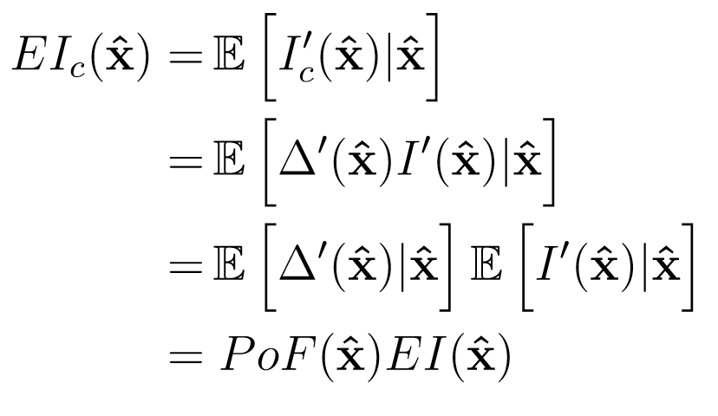
What About a Constraint?
Constrained Expected Improvement
Choose next point by multiplying EI by PoF
PoF eliminates infeasible regions from EI
Choose maximum of constrained expected improvement (EI_{C})
Calculate EI_{c} over sample of design space and used gradient-based optimization

Slide 12
Reflected ²³⁵U Sphere
Where is intermediate sensitivity of ²³⁵U maximized but system is critical?
  Modeled with MCNP6.2
Free parameters:
  Radius of U-235 (95 wt%) sphere
  Thickness of polyethylene reflector
Known solution!
Almost bare critical sphere
t_{ref}
r_{U235}
²³⁵U
Polyethylene

Slide 13
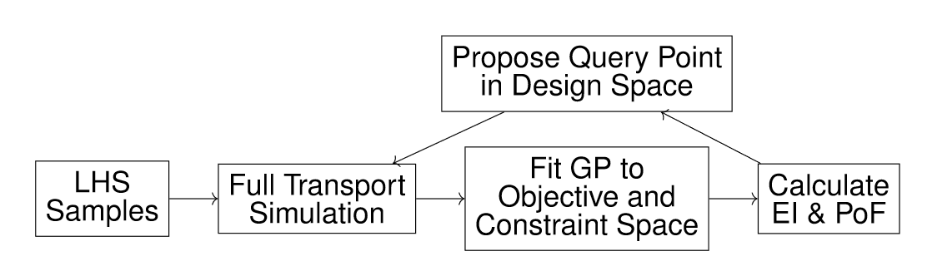
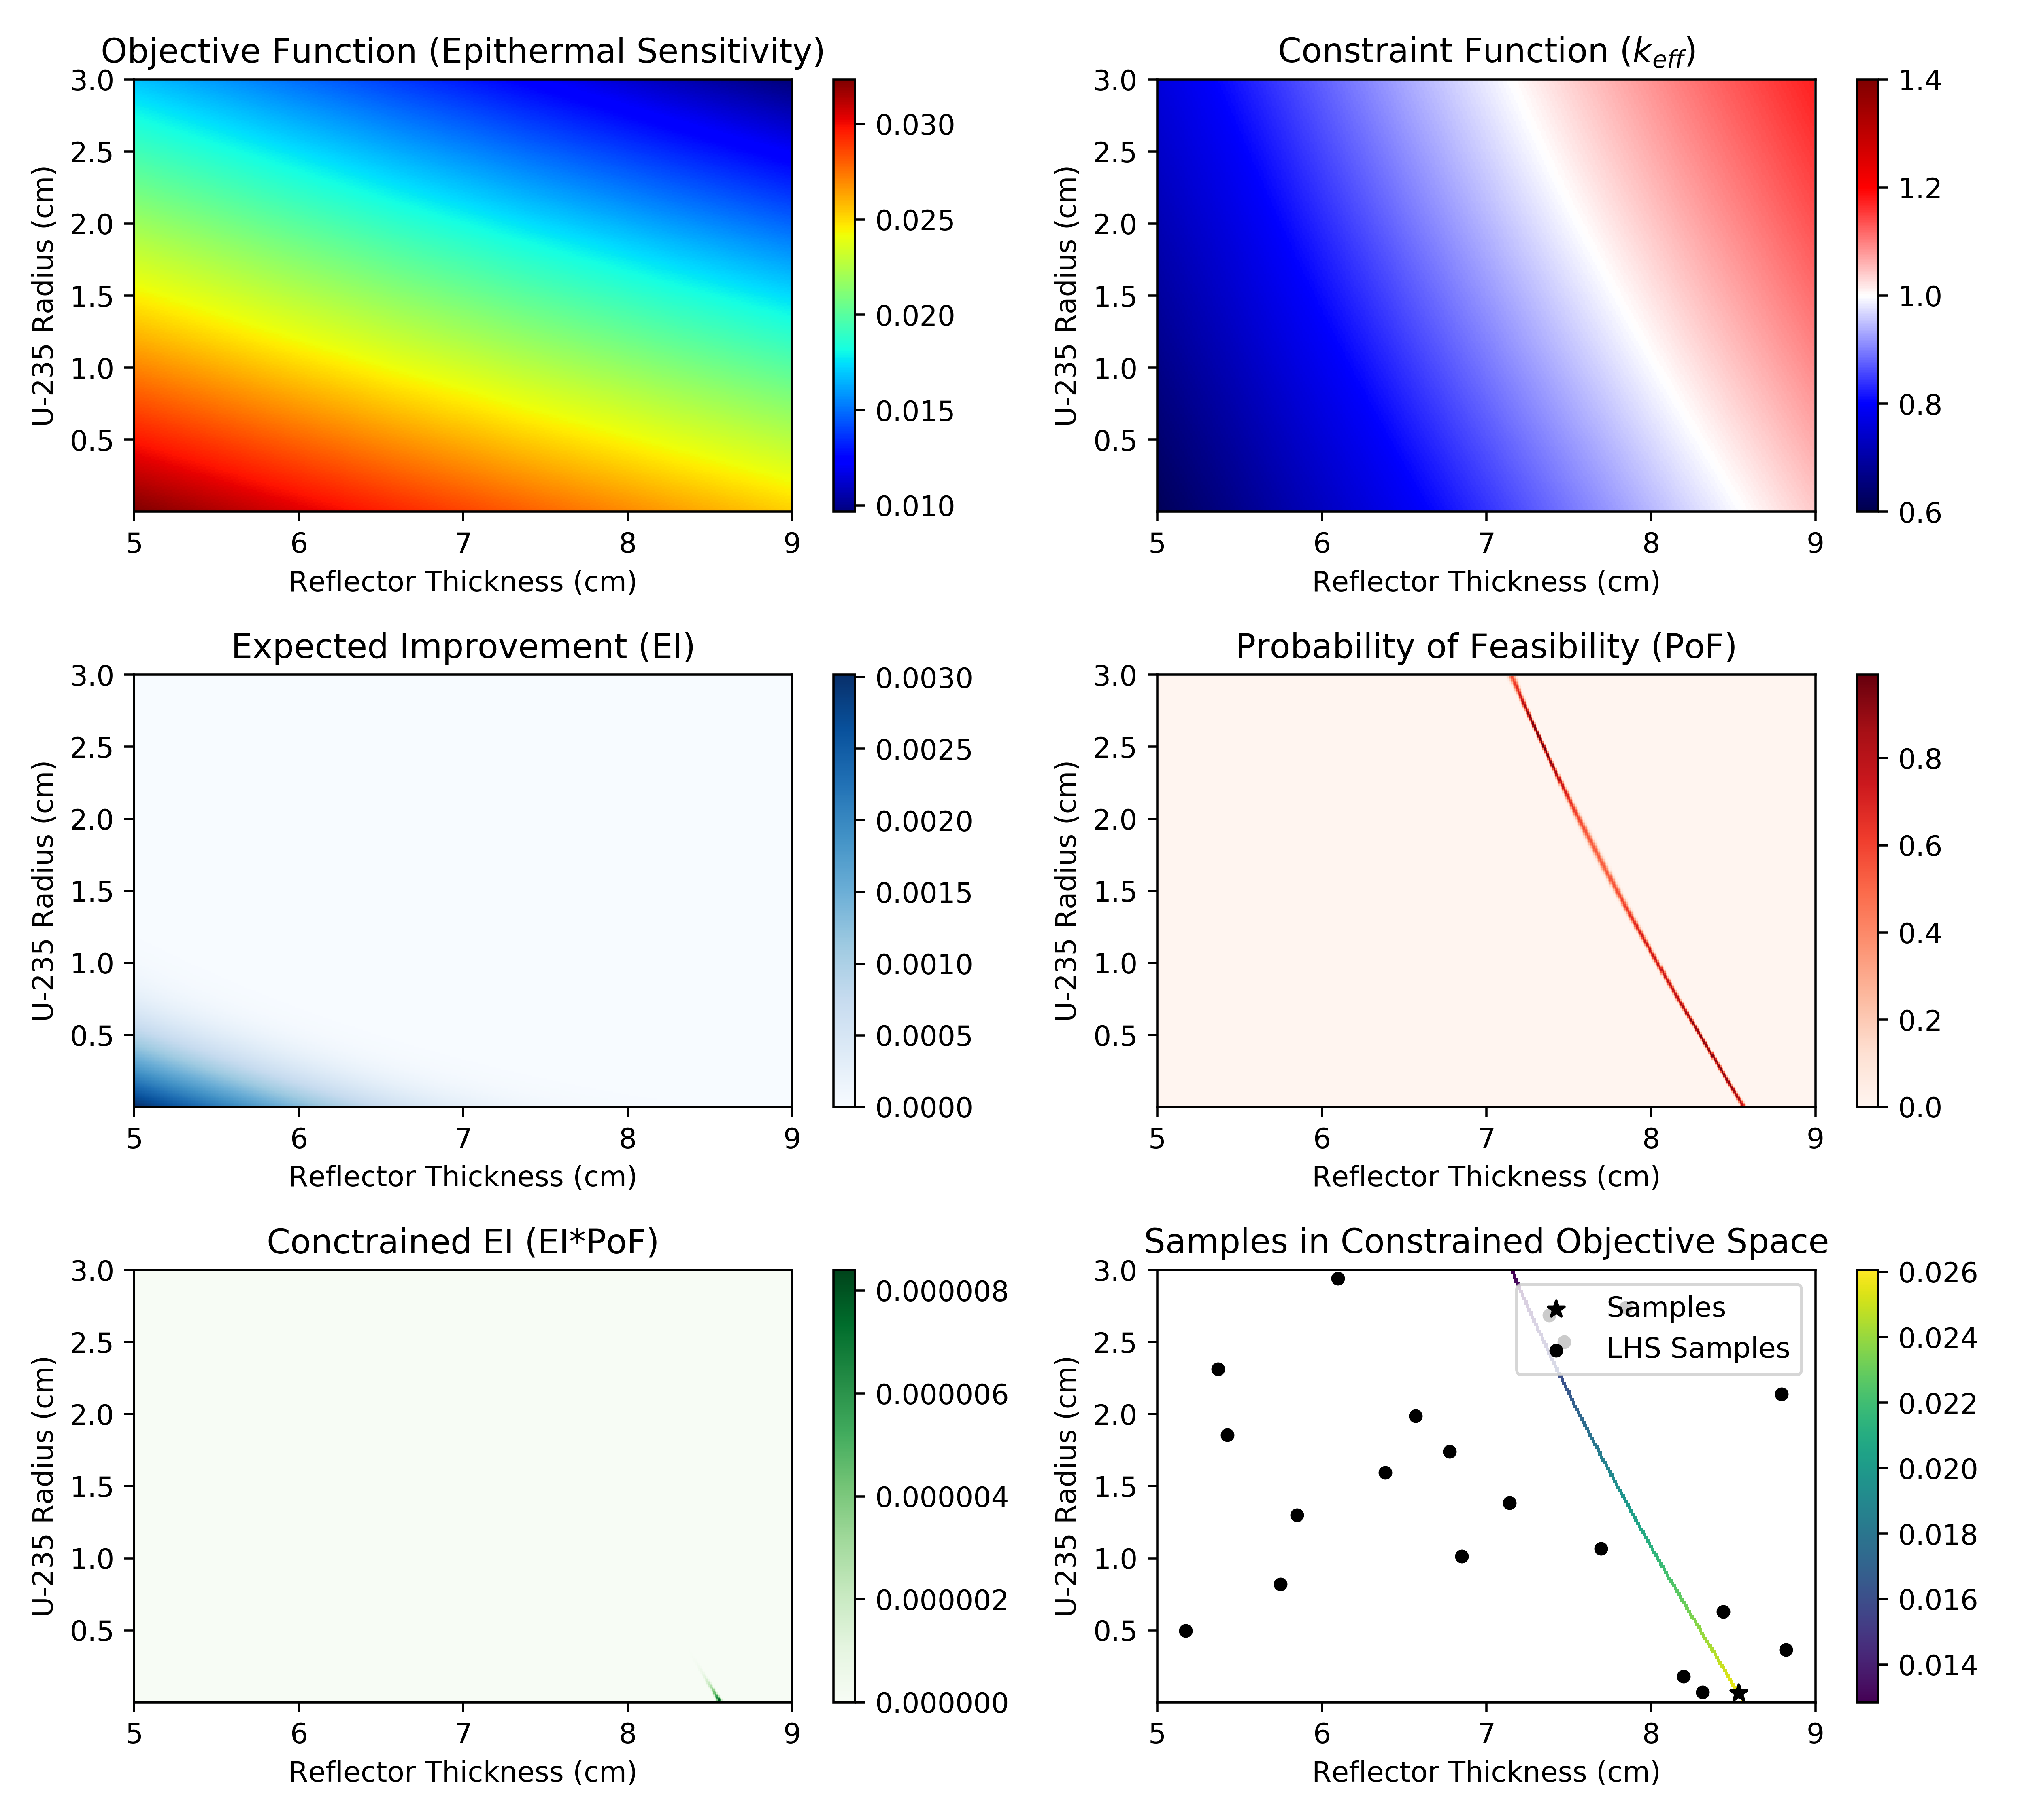
Initial Fit

Slide 14
Pick Next MCNP Execution

Slide 15
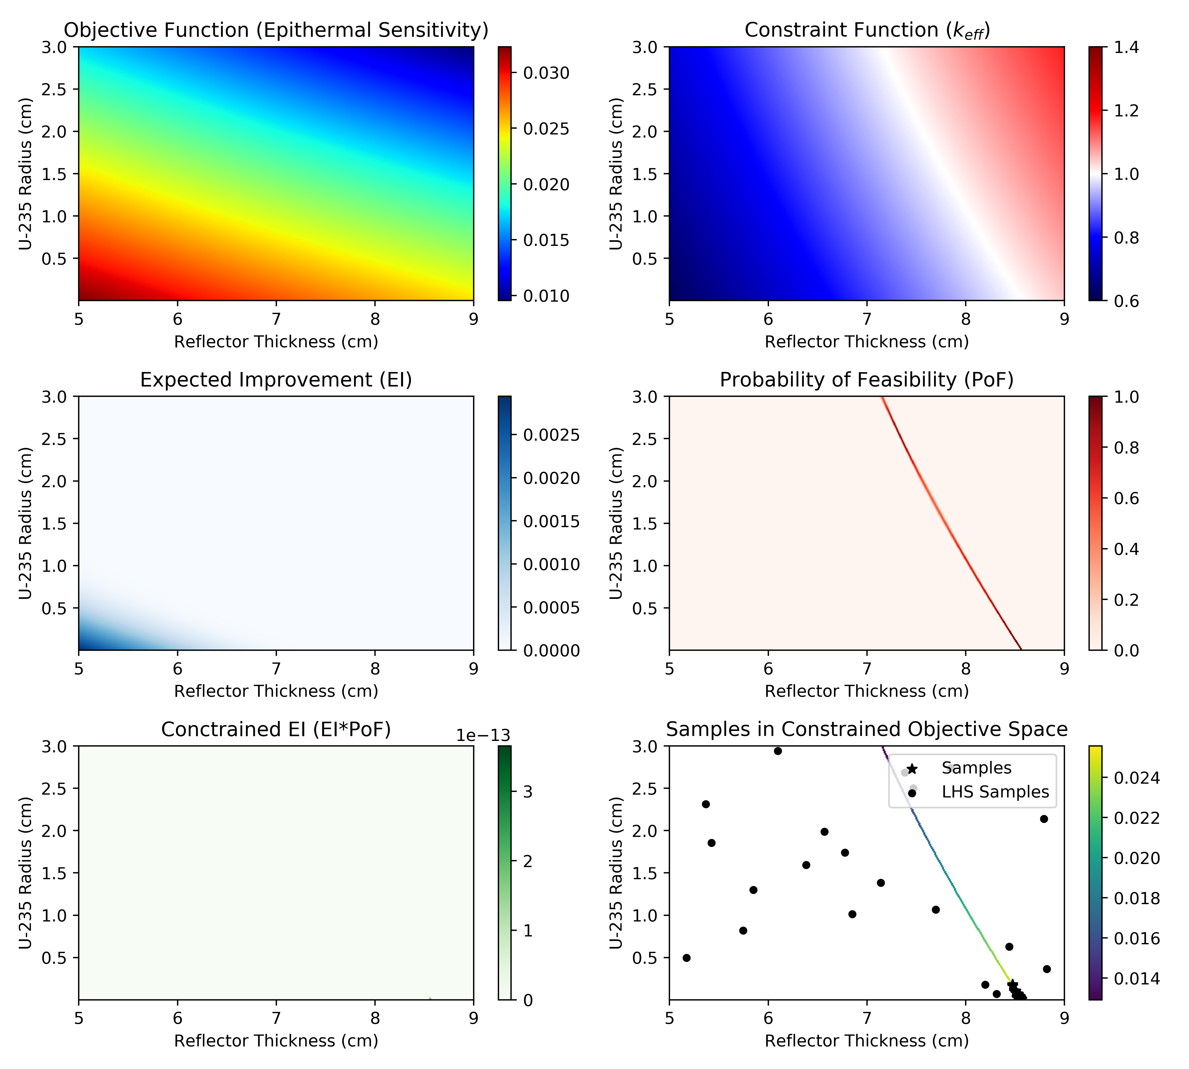
Thirty More Queries
x 15

Slide 16
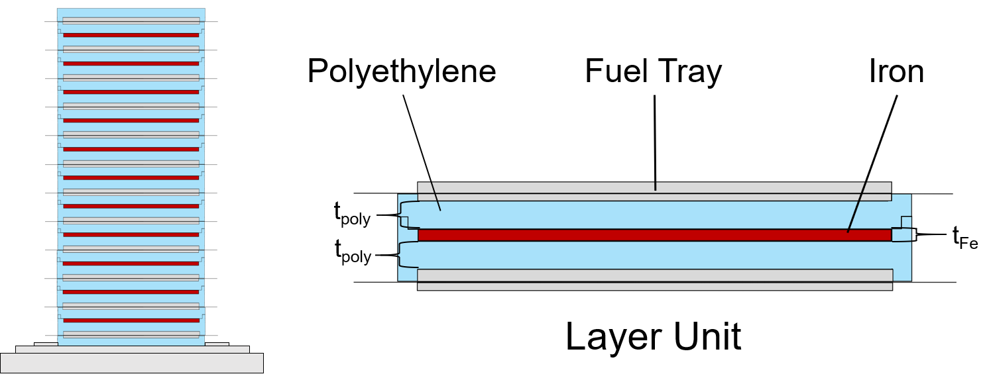
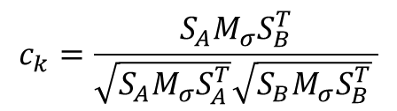
Design of TEX Experiment
Make a critical TEX that maximizes similarity with nuclear waste of Hanford Tank Farm
  For Whisper USL estimations
Design parameters:
  Thickness of polyethylene moderator
  Thickness of iron/manganese absorber
  Number of layers in stack
Constraints:
  MCNP k_{eff} = 1 ± 150 pcm
  Height/width ratio < 2
  Separated stack k_{eff} < 0.9
  Weight
$$c_{k}=\frac{S_{A}M_{σ}S_{B}^{T}}{\sqrt{S_{A}M_{σ}S_{A}^{T}}\sqrt{S_{B}M_{σ}S_{B}^{T}} }$$

Slide 17
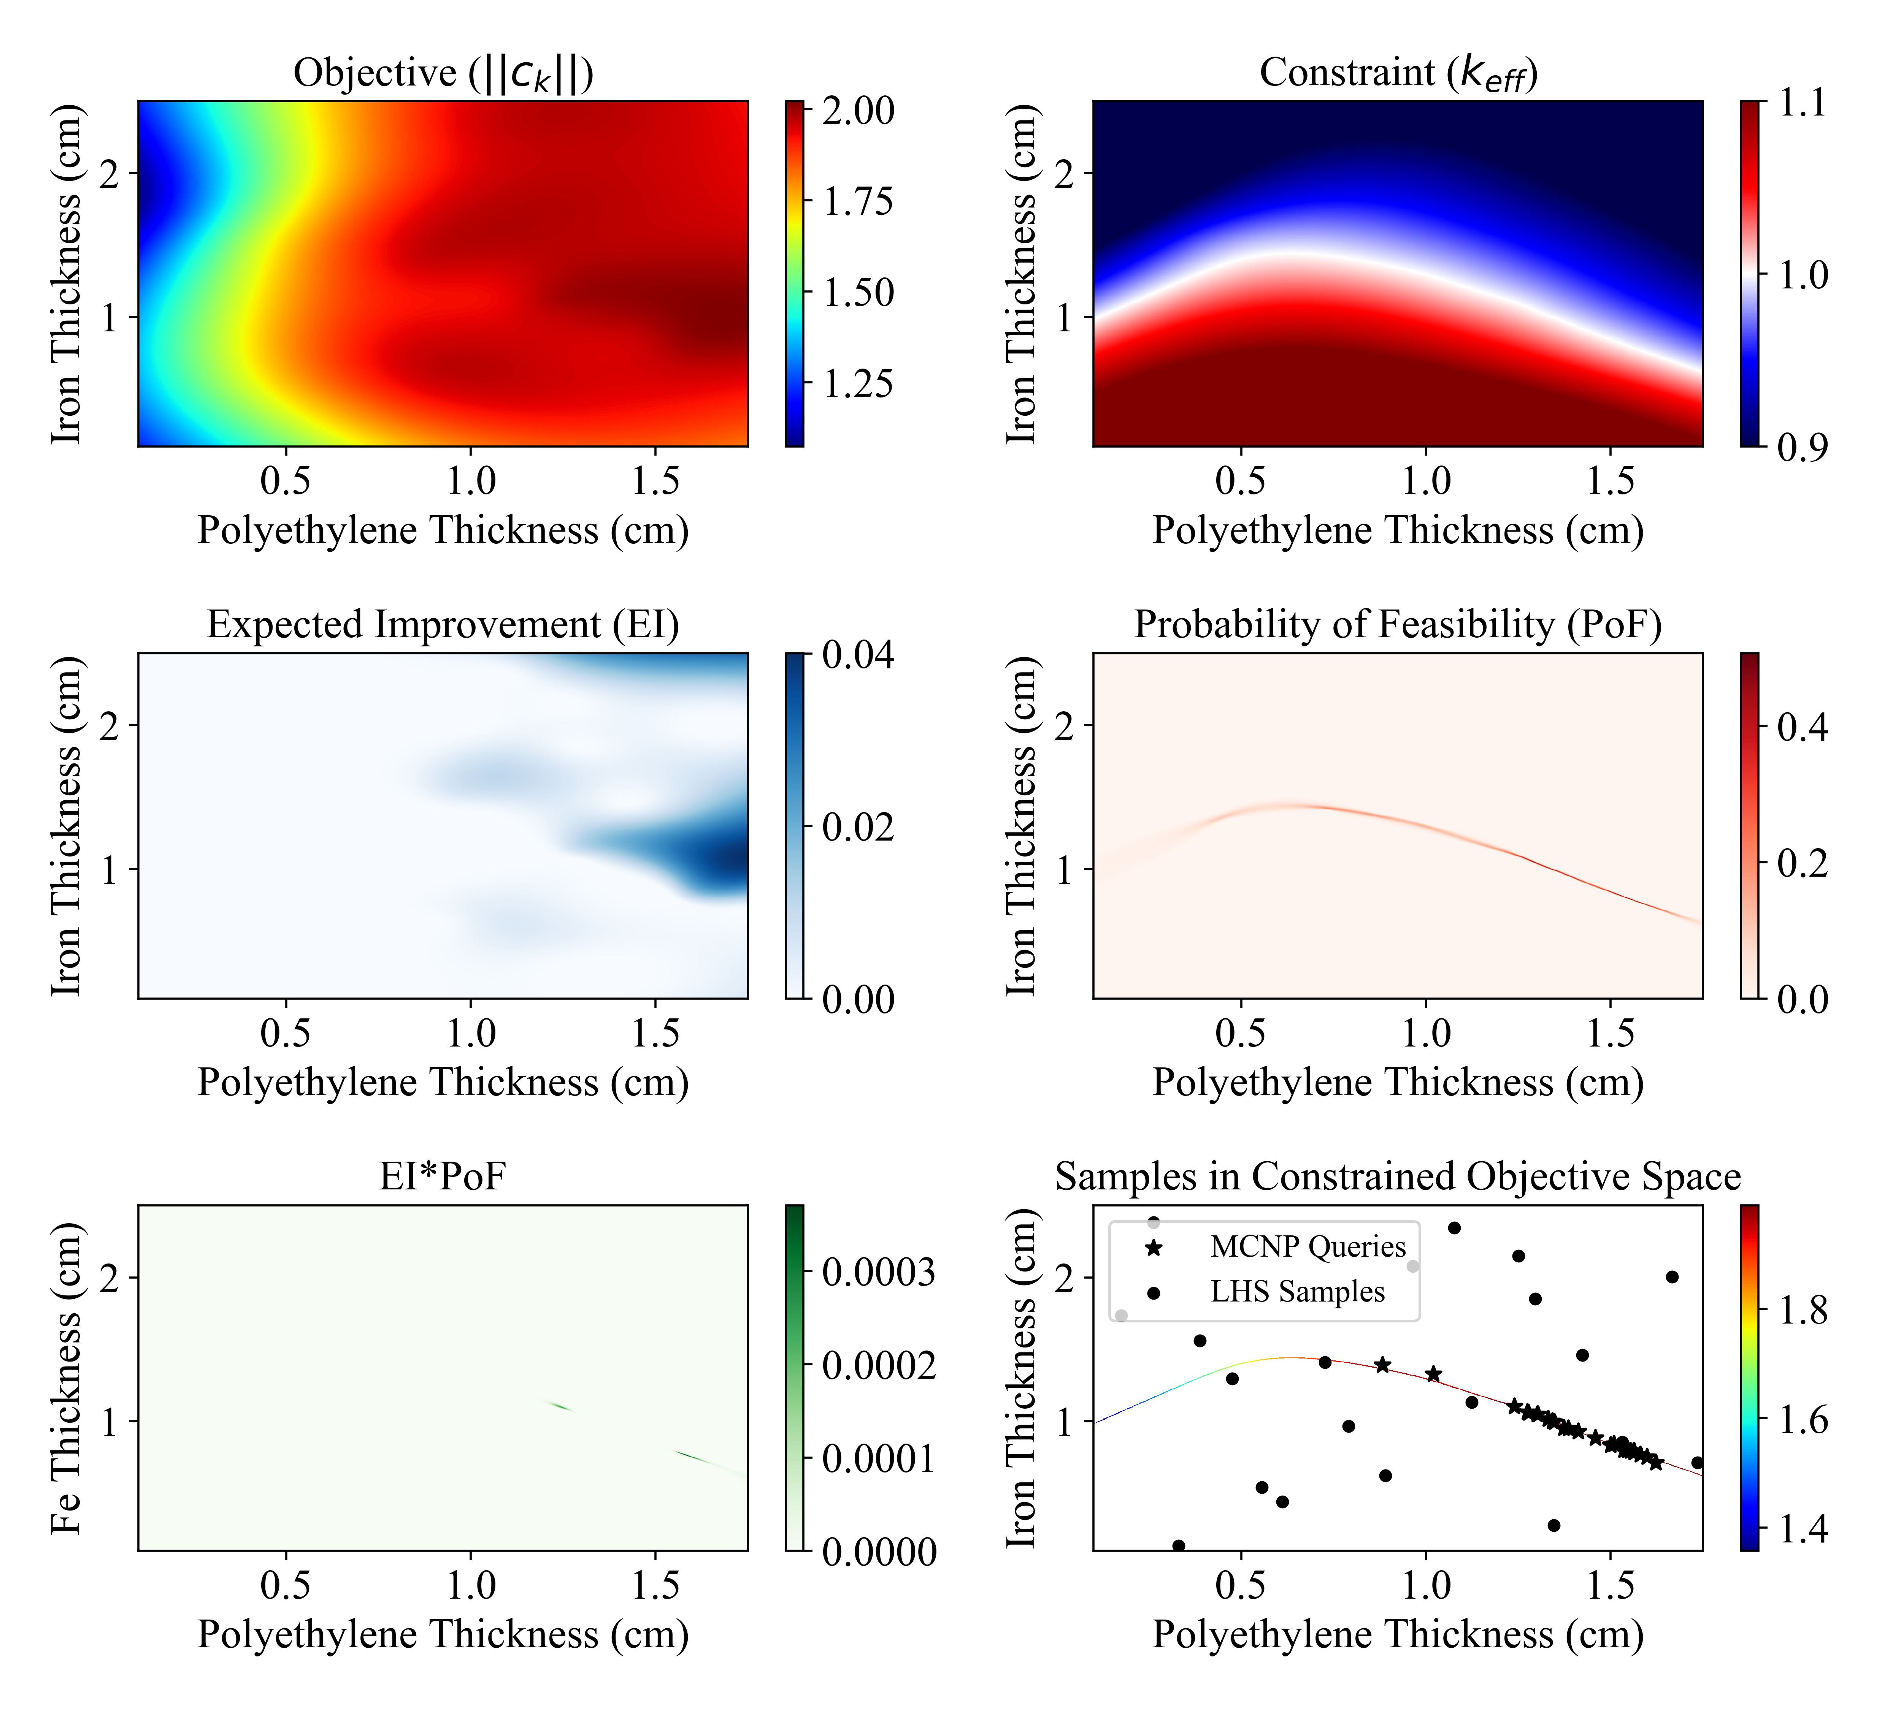
Constrained Bayesian Optimization Results

Slide 18
MCNP Queries in Regions of Interest

Slide 19
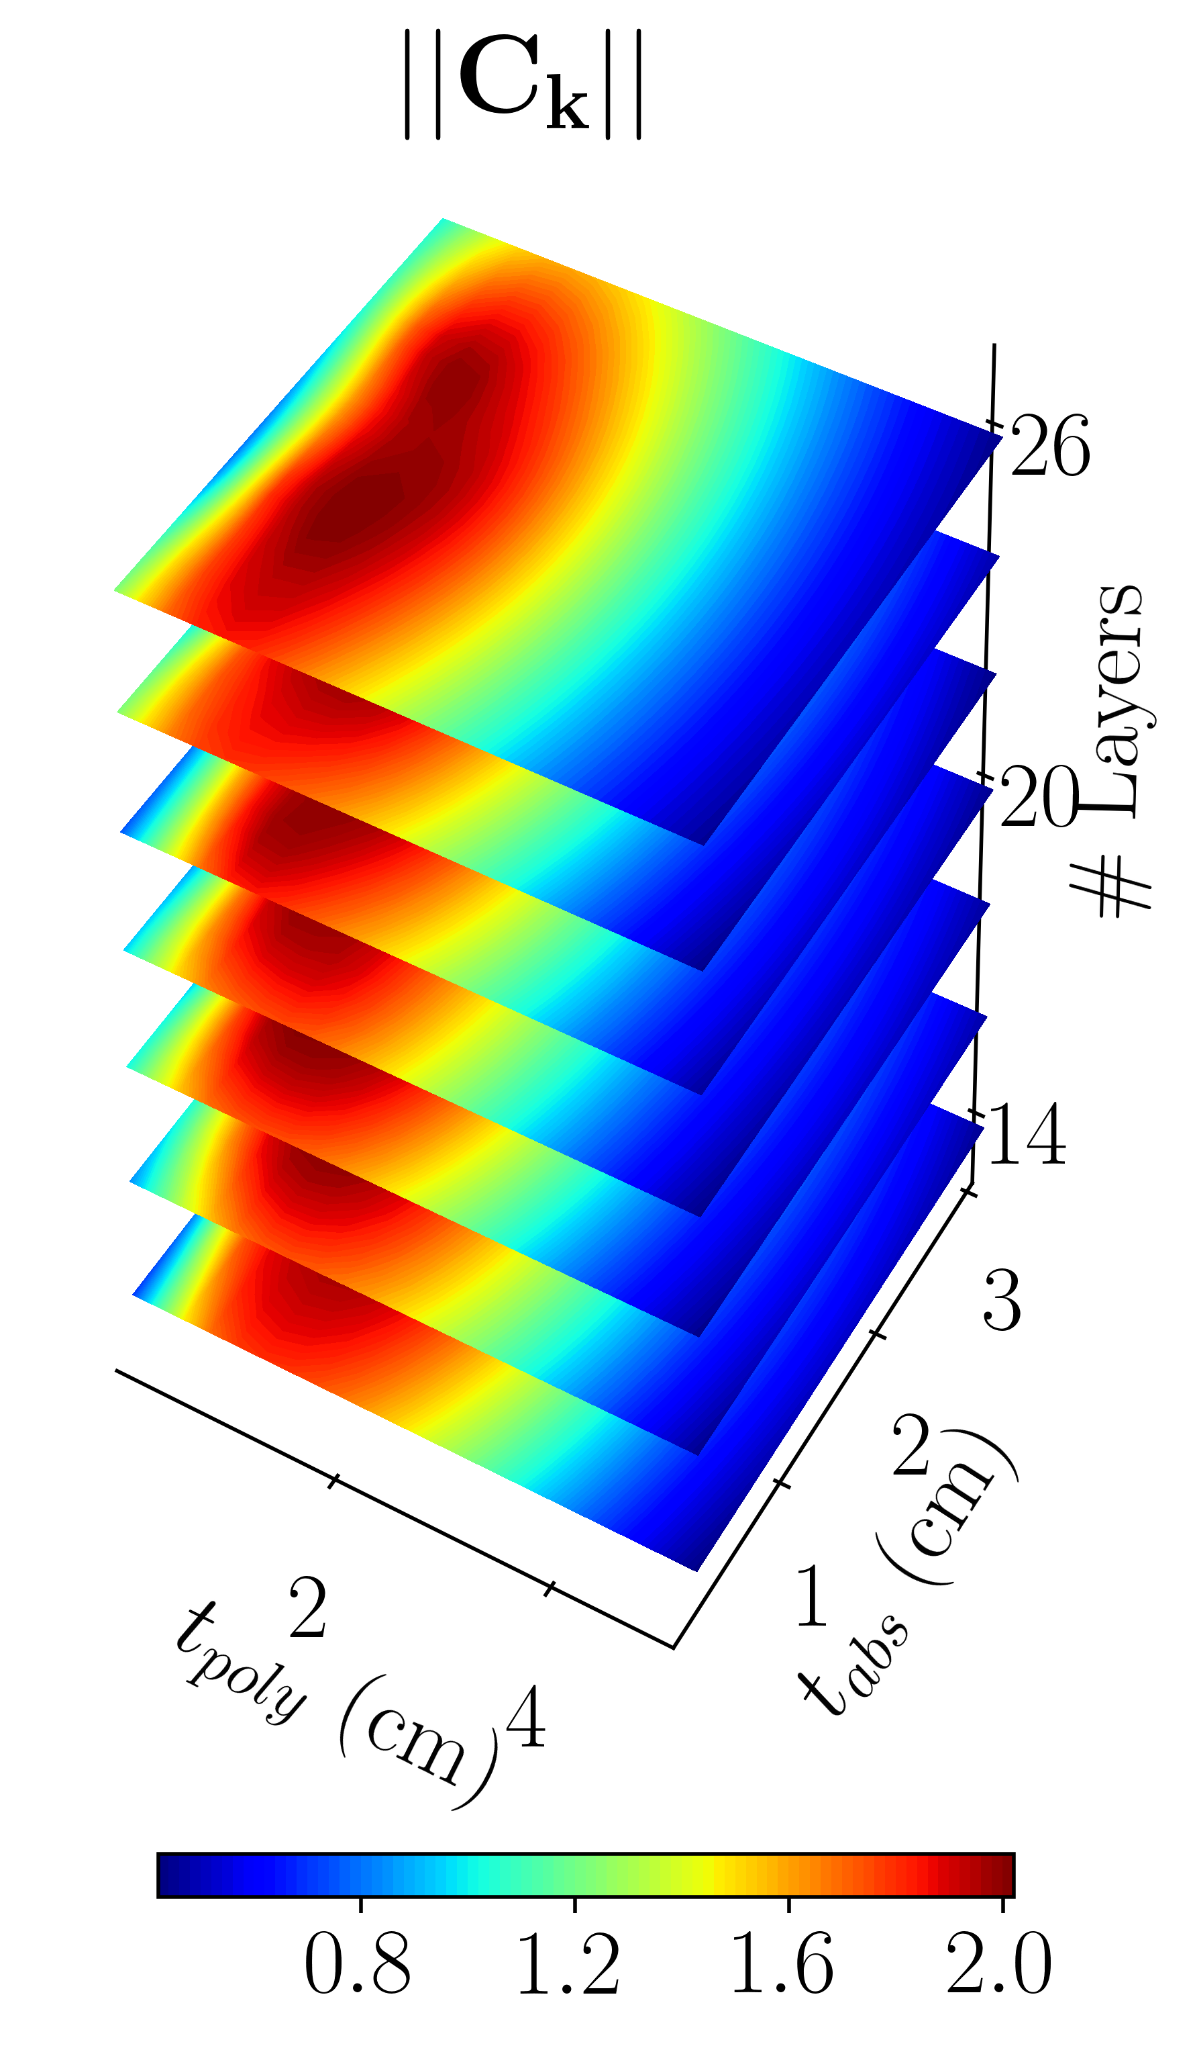
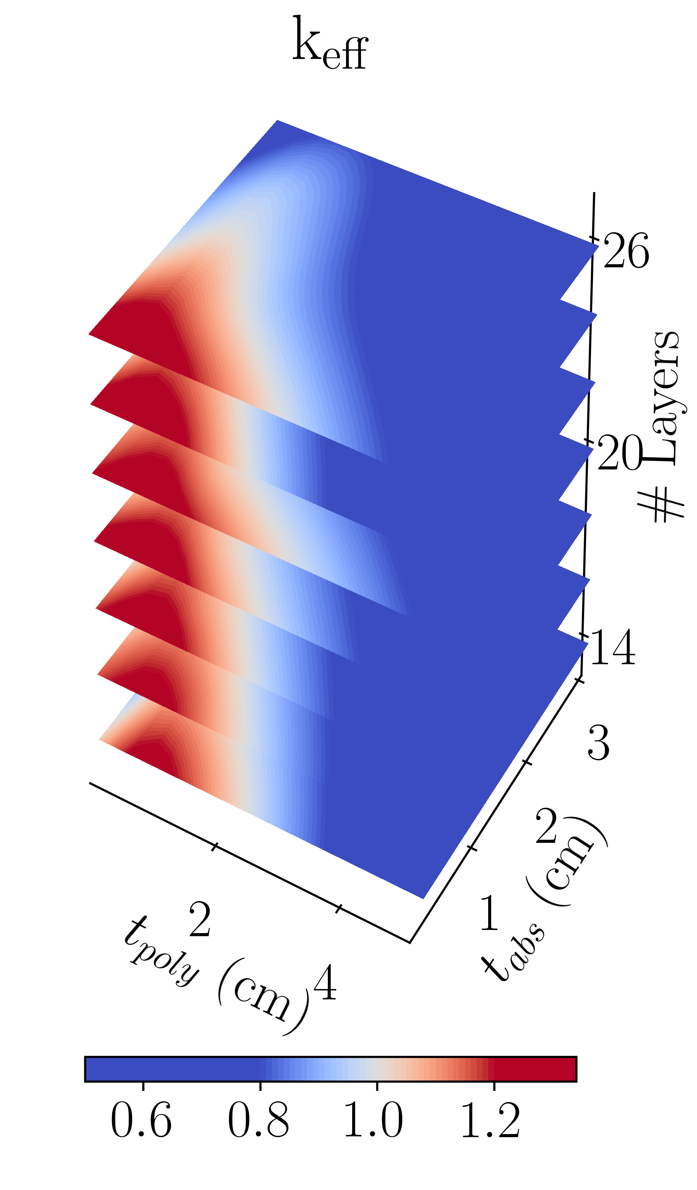
Levels of Categorical Variable

Slide 20
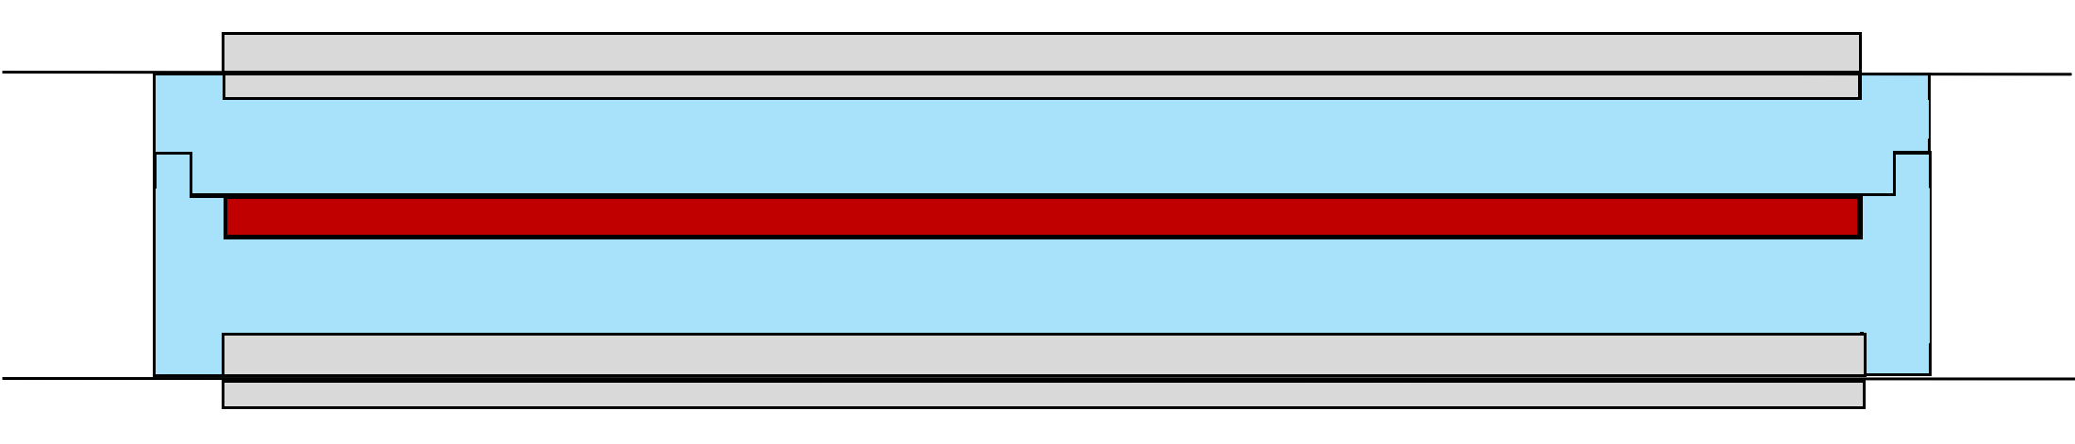
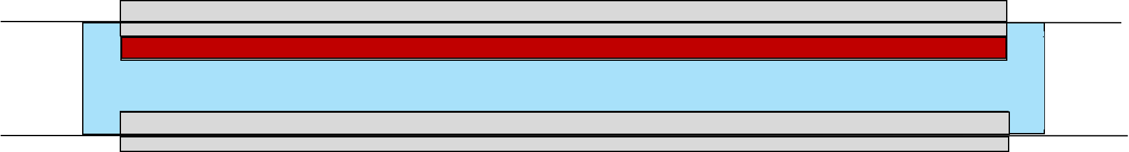
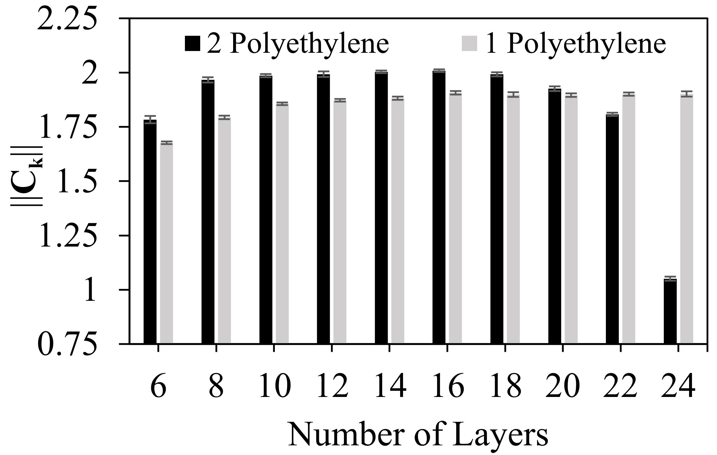
Search Through Design Space
Constraints

Slide 21
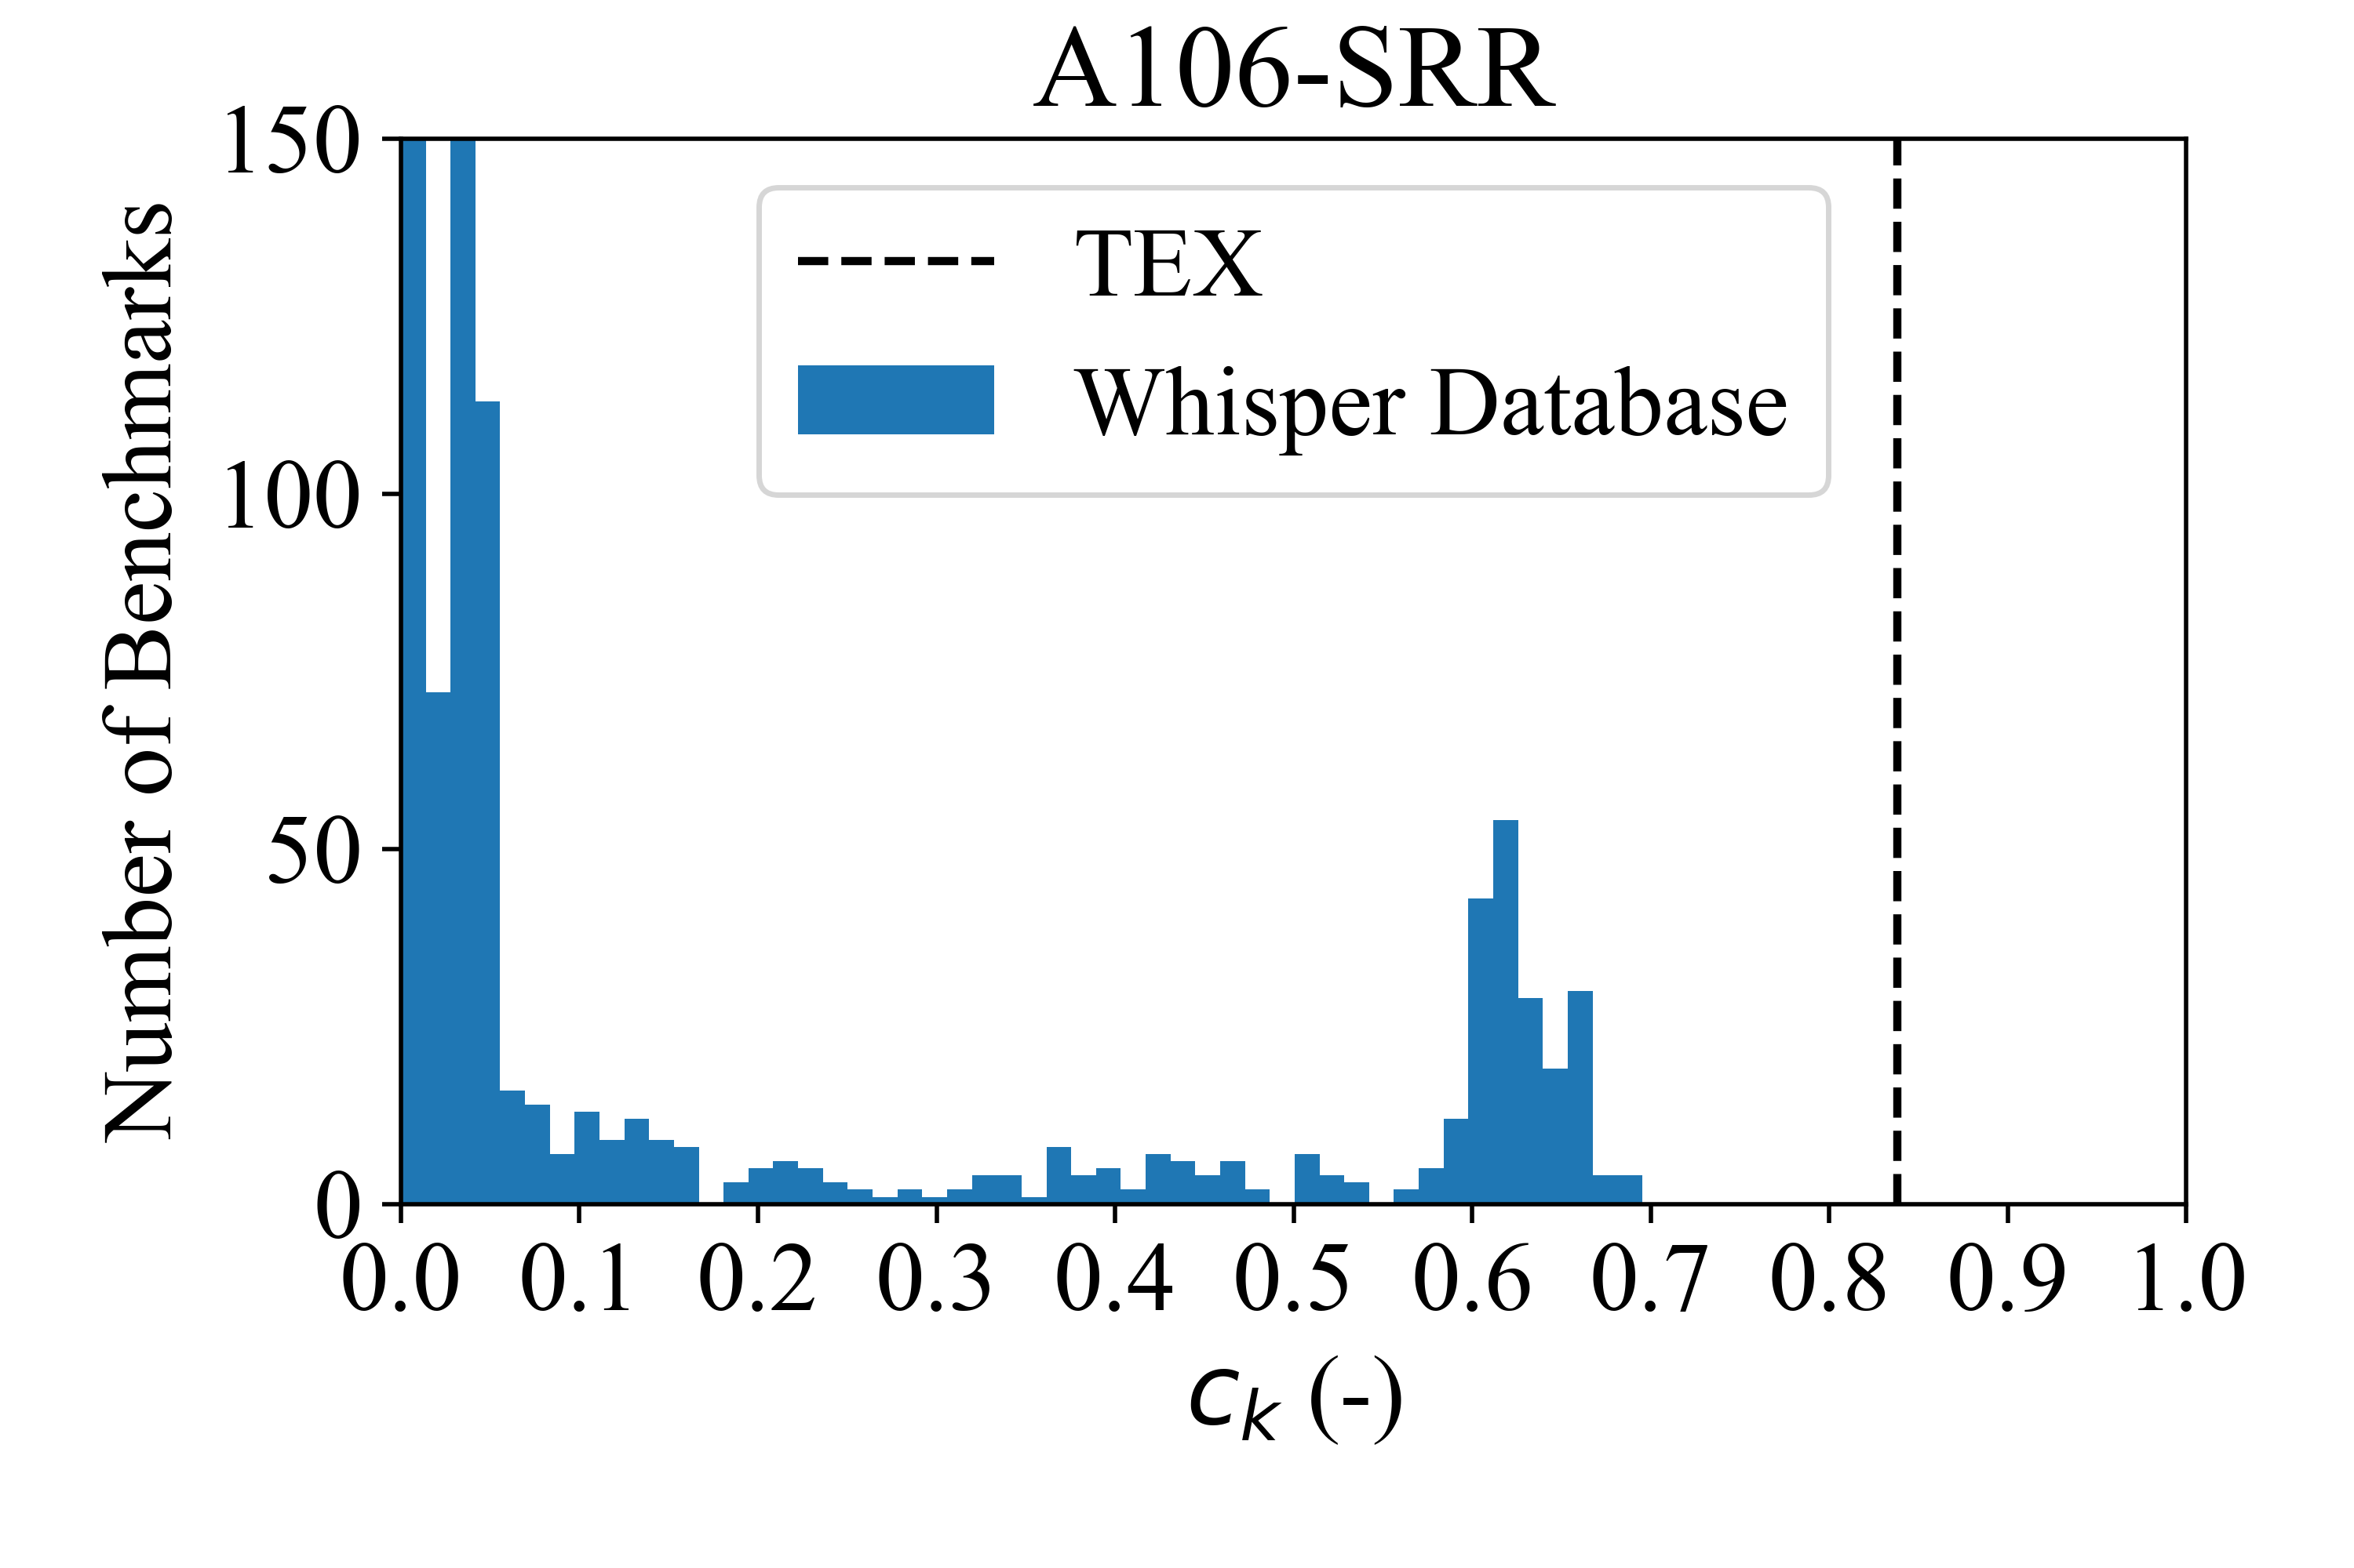
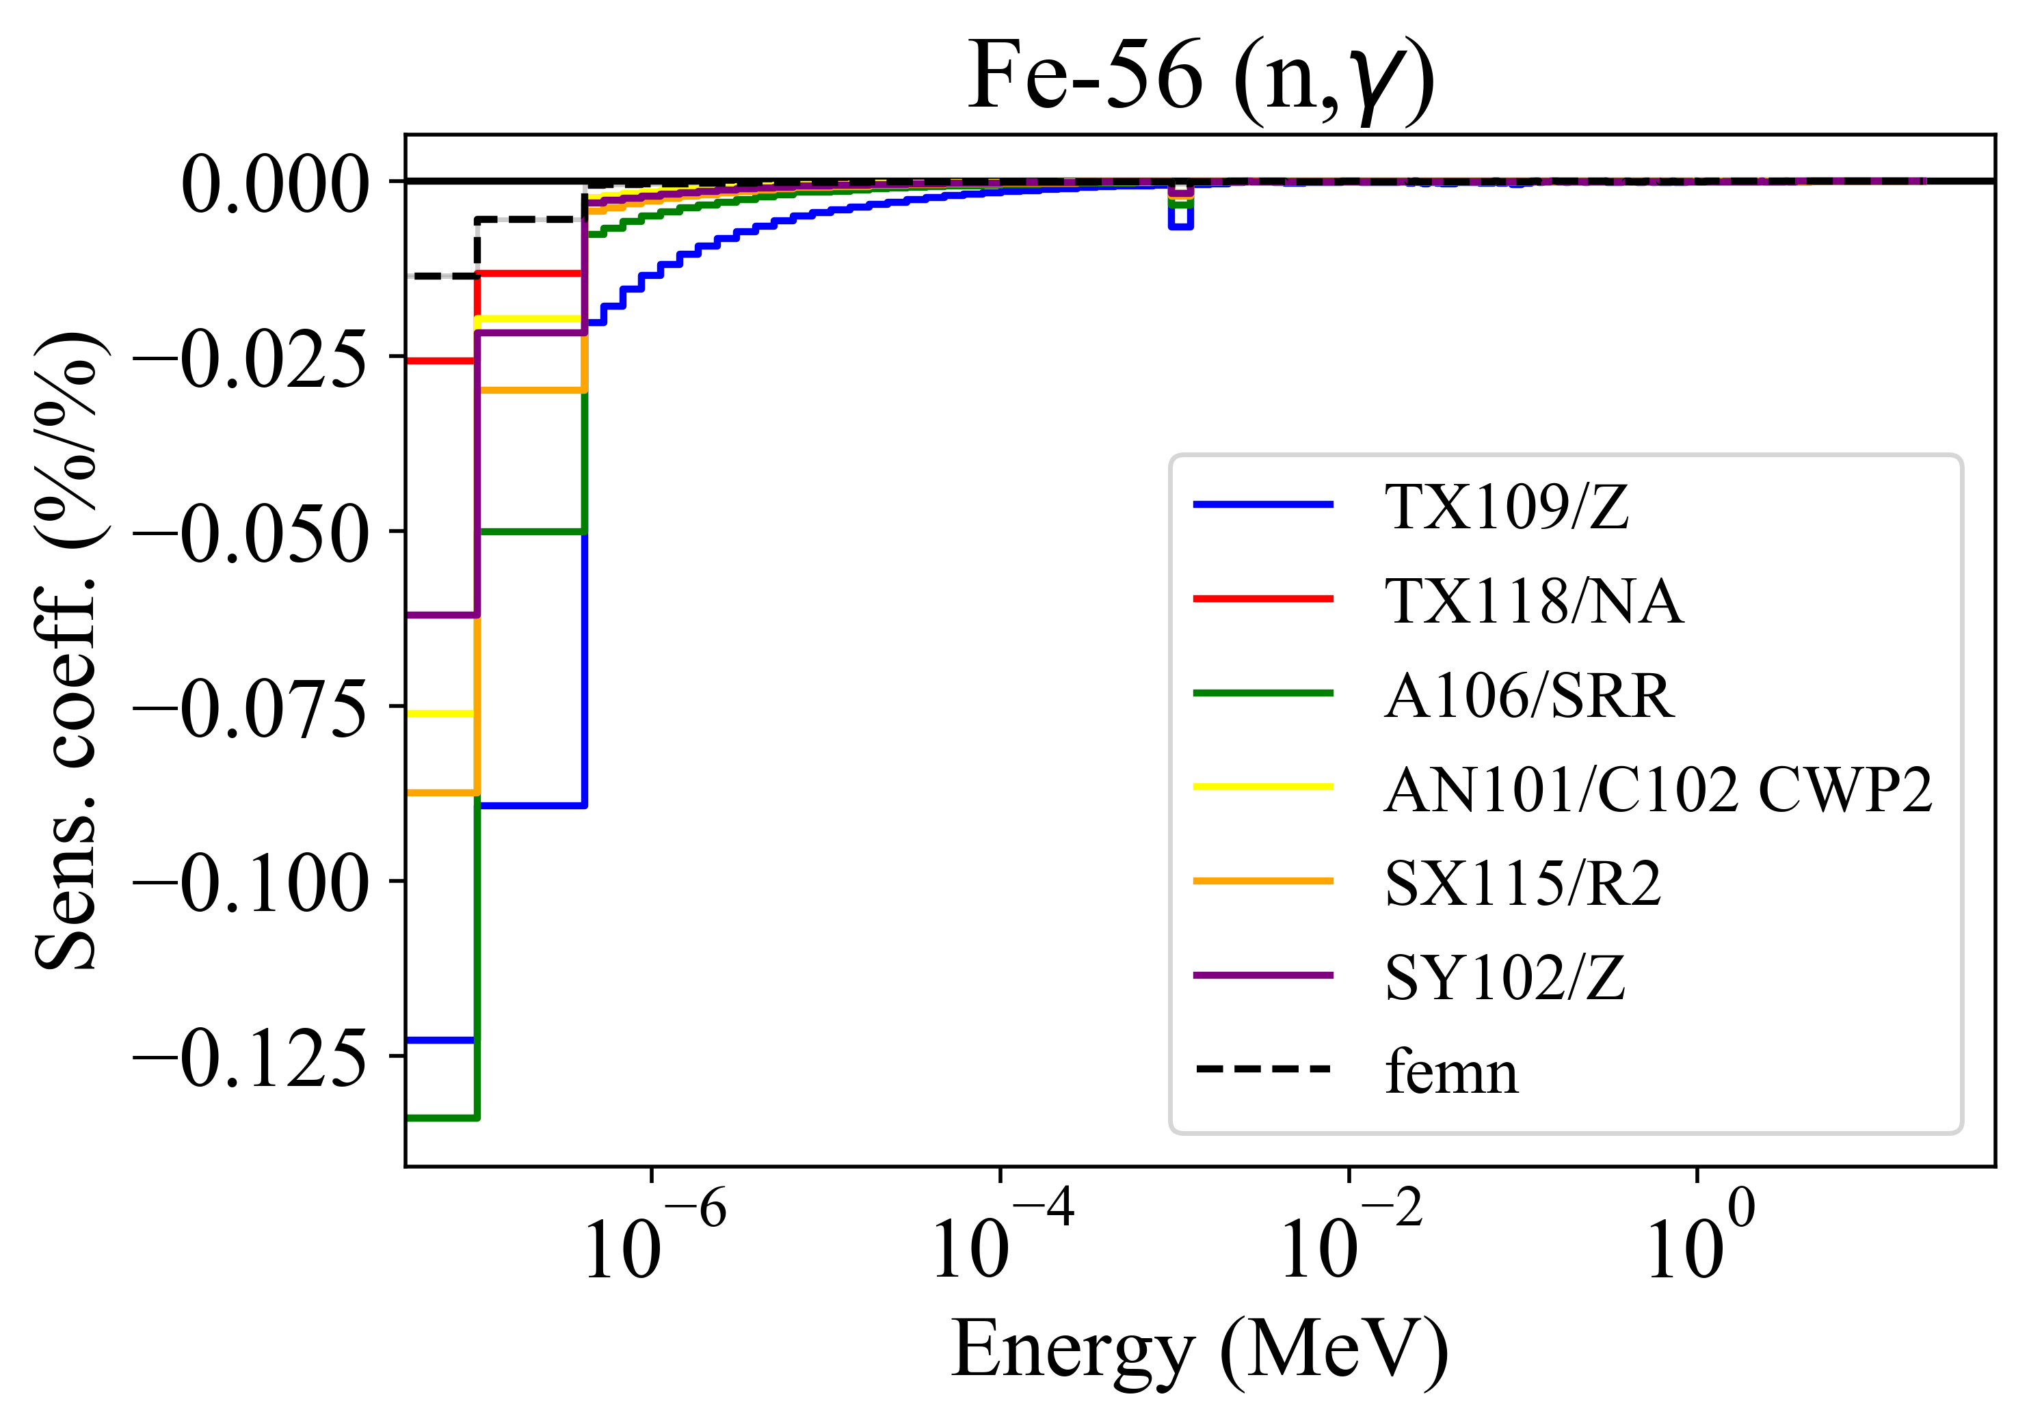
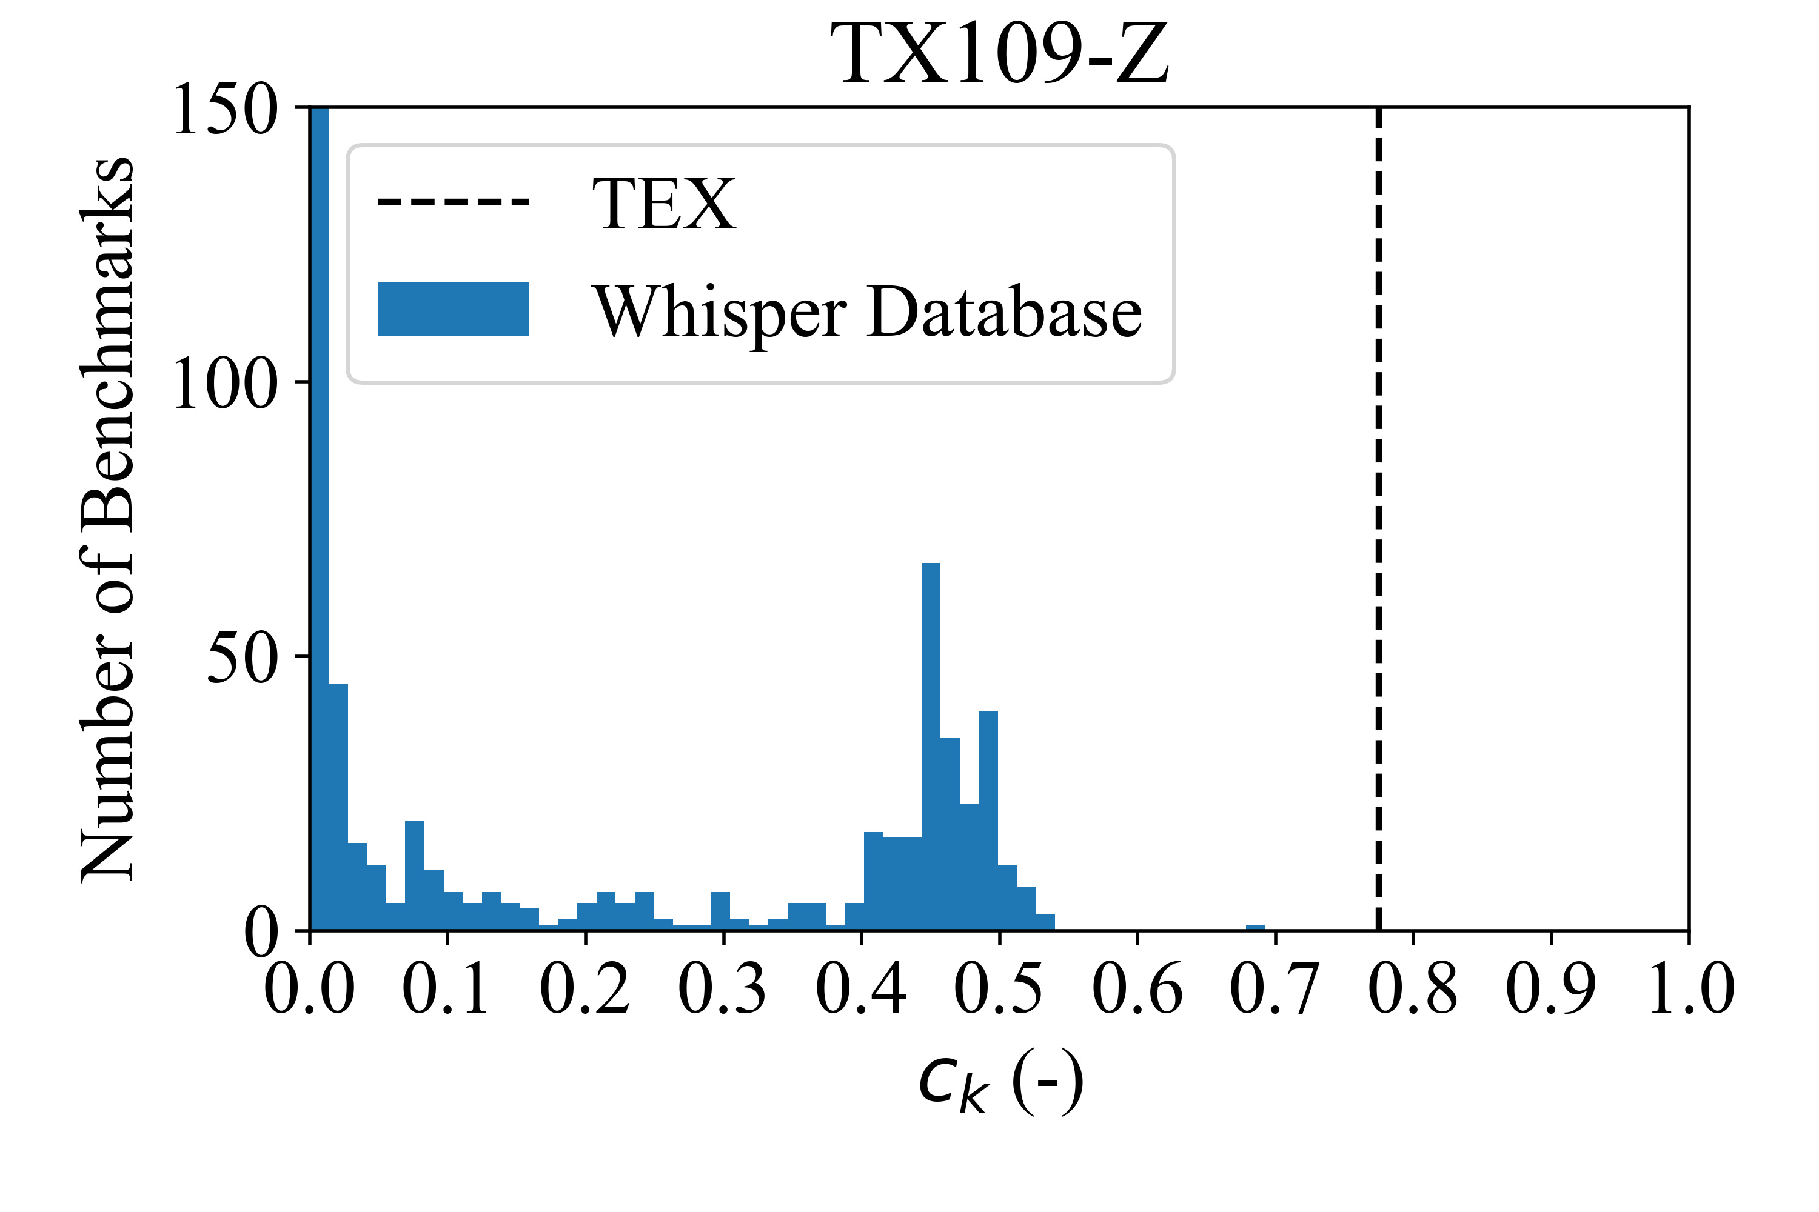
Search Through Design Space

Slide 22
Conclusions
GP & Bayesian Optimization allows for efficient experiment design
Challenges:
  High dimensional design spaces
  Mixed qualitative/quantitative variables
Current work: Bayesian neural networks
  Scales linearly with size of training data
  Easily accommodates mixed Q/Q variables
Reference:
  Constrained Bayesian optimization of criticality experiments
  D Siefman, C Percher, J Norris, A Kersting, D Heinrichs
  Annals of Nuclear Energy 151 (2021)
Questions?

Slide 23
Disclaimer
This document was prepared as an account of work sponsored by an agency of the United States government. Neither the United States government nor Lawrence Livermore National Security, LLC, nor any of their employees makes any warranty, expressed or implied, or assumes any legal liability or responsibility for the accuracy, completeness, or usefulness of any information, apparatus, product, or process disclosed, or represents that its use would not infringe privately owned rights. Reference herein to any specific commercial product, process, or service by trade name, trademark, manufacturer, or otherwise does not necessarily constitute or imply its endorsement, recommendation, or favoring by the United States government or Lawrence Livermore National Security, LLC. The views and opinions of authors expressed herein do not necessarily state or reflect those of the United States government or Lawrence Livermore National Security, LLC, and shall not be used for advertising or product endorsement purposes.

Slide 24
Gaussian Process
(Kriging Metamodel¹)
Similar designs have similar underlying physics
  Highly correlated because the physics is the same
  Example: If I know k_{eff} at 1.000 cm thick reflector, easy to predict k_{eff} at 1.001 cm
Dissimilar designs have very different physics
  Uncorrelated or anti-correlated
  Example: anti-correlation in under- vs. over-moderated reactor
Idea: Use a probability distribution as the surrogate model
  ‘Gaussian’ comes from using normal distribution
  Analytical solutions are possible
  Incorporates uncertainty of training data
Predict variable based on the degree of correlation with training data
¹Krige, Danie G. (1951). "A statistical approach to some basic mine valuation problems on the Witwatersrand". J. of the Chem., Metal. and Mining Soc. of South Africa. 52 (6): 119–139

Slide 25


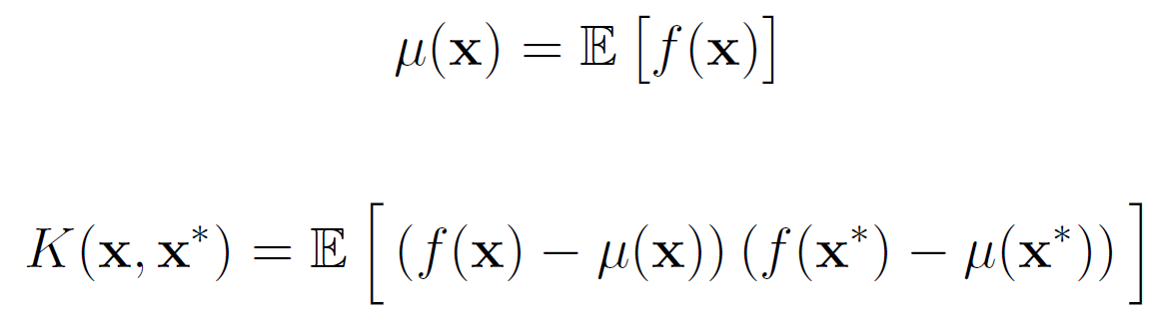

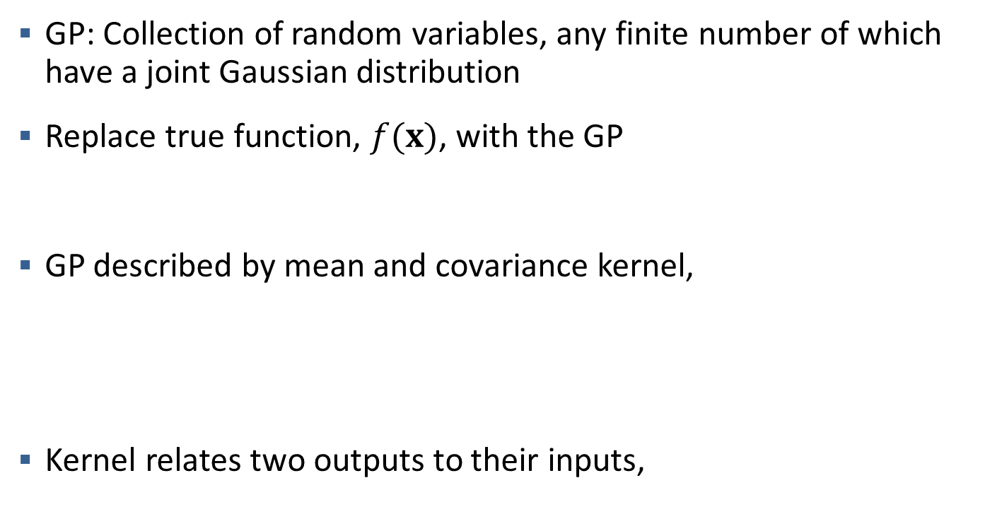
Basic Gaussian Process (GP)
GP: Collection of random variables, any finite number of which have a joint Gaussian distribution
Replace true function, $f(x)$, with the GP
GP described by mean and covariance kernel,
Kernel relates two outputs to their inputs,

Slide 26
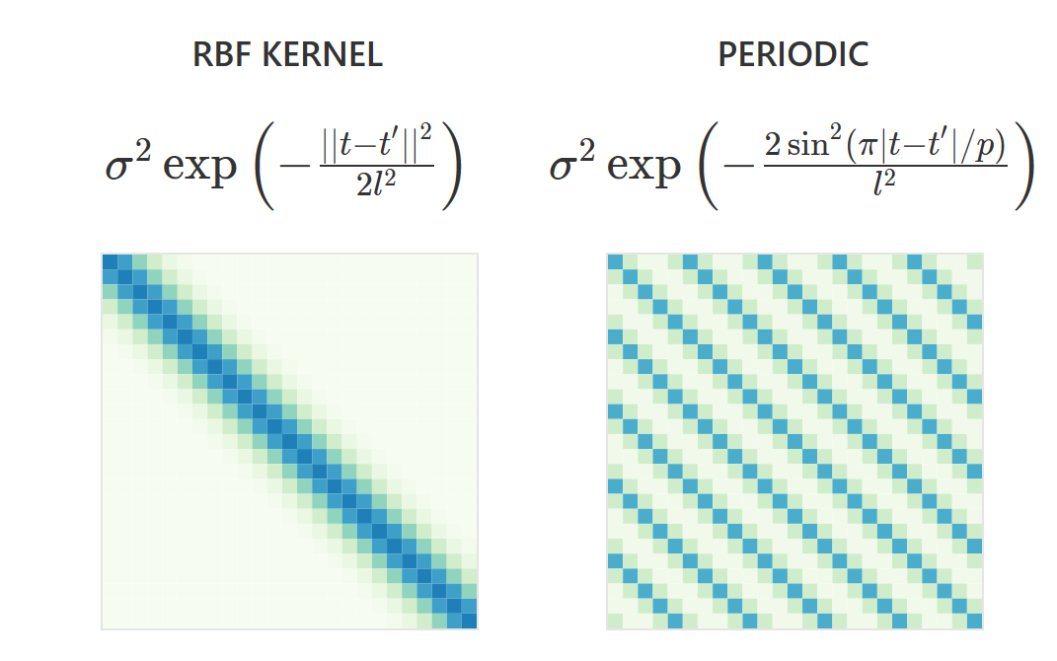
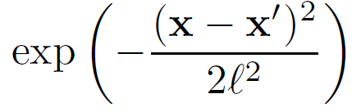



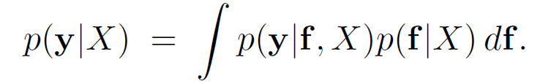
Kernel to Describe Covariance
Kernel described by mathematical models
  Best kernel depends on f(x)
Fit Kernel to training data
Maximize marginal likelihood
Görtler, et al., "A Visual Exploration of Gaussian Processes", Distill, 2019.

Slide 27
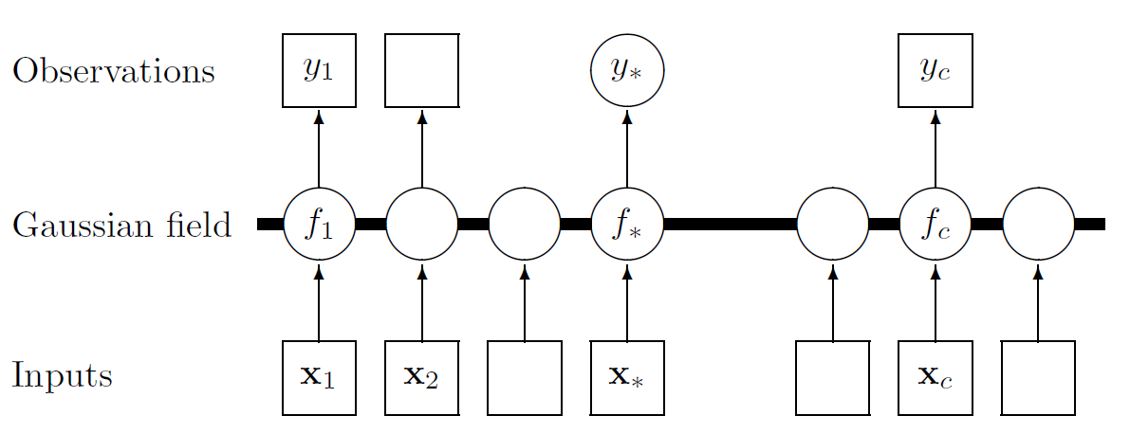

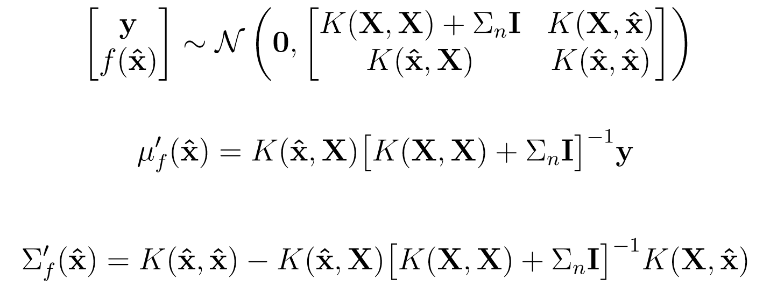
Predictions with Gaussian Processes
C.E. Rasmussen & C.K.I. Williams, Gaussian Processes for Machine Learning, the MIT Press, 2006
Notes:
Squares are known values (maybe have noise) and circles are unknown values. We don’t know the true function f, we don’t know the y value at x* that we want. We do know the y values associated with x1 and xc. We can get the mean of f and the covariance of f as estimate of y*, or f* and cov(f*). Likewise, we can just sample the normal distribution to get a random point for f*

Slide 28
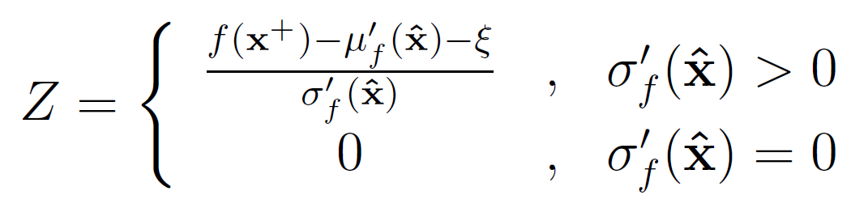
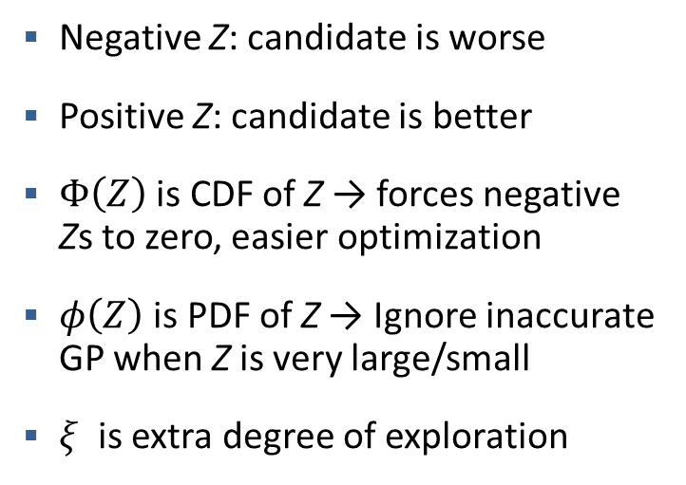
Expected Improvement (EI)
An Acquisition Function
Normalization to get standard normal distribution
Negative Z: candidate is worse
Positive Z: candidate is better
$Φ\left(Z\right)$ is CDF of Z → forces negative Zs to zero, easier optimization
$φ\left(Z\right)$ is PDF of Z → Ignore inaccurate GP when Z is very large/small
$ξ$ is extra degree of exploration
Notes:
Z is a standard normal distribution: mean of zero and std of 1. Normalization gives it this special property
Why ignore large inaccurate Z? That’s kind of counter intuitive. Well yea, but those will already get a high EI from exploitation bit

Slide 29


Expected Improvement (EI)
An Acquisition Function
Next training point to add is where EI is maximum
Two reasons to choose this point as next training datum:
Exploit: Point Nearer to Optimum
Explore: Point Improves GP Accuracy
Notes:
Z is a standard normal distribution: mean of zero and std of 1. Normalization gives it this special property
Multiply by CDF

Slide 30
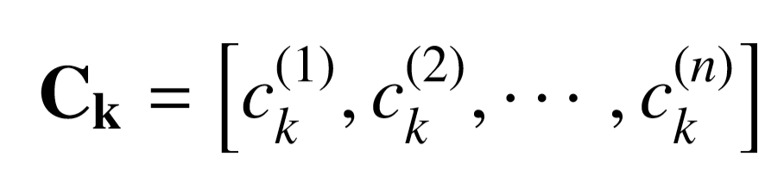
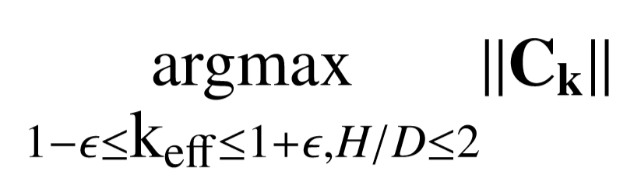
Multi-Objective Optimization
177 tanks at Hanford site
  Compositions vary within and between tanks
Use c_{k} of six tanks used that are most representative/limiting
Tank/Layer | Pu Mass (kg) | U Mass (kg) | Fe Mass (kg) | Mn Mass (kg) | H-X
TX-109/Z | 10.48 | 0 | 1.800 | 0 | 142
TX-118/NA | 29.15 | 0 | 0.7020 | 0.624 | 215
A-106/SRR | 45.08 | 136,100 | 4.490 | 0.241 | 285
AN101/C-102 CWP2 | 155.9 | 1,669 | 6.560 | 1.130 | 431
SX-155/R2 | 22.88 | 147.3 | 1.370 | 0.330 | 333
SY-102/Z | 134.9 | 881.0 | 5.780 | 1.590 | 1,590

